Slide 1
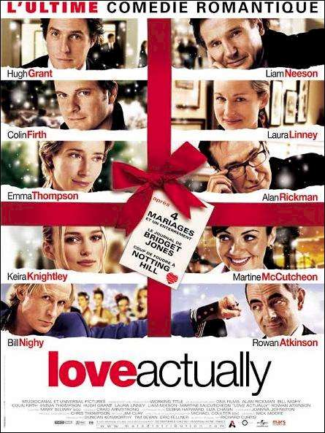
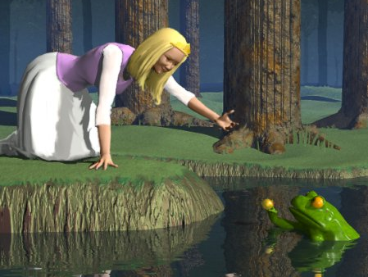
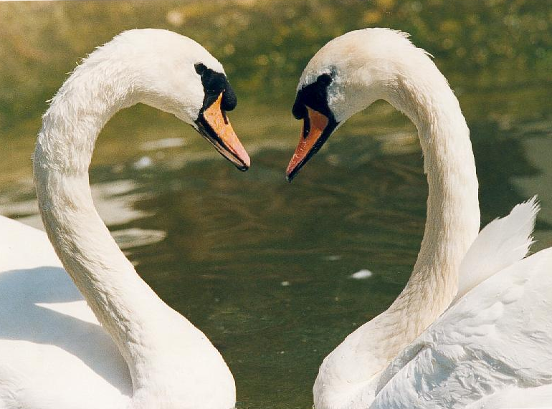

Relationships

Slide 2
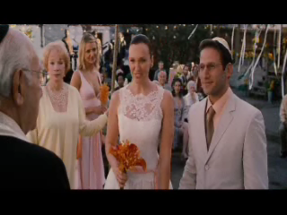

Slide 3
The Need for Relationships
Extremely happy people (Diener & Seligman, 2002)
Know thyself
  Lasagna principle revisited
  Extraversion and introversion (Little, 1993)
Intimate relationships
“There are few stronger predictors of happiness than a close, nurturing, equitable, intimate, lifelong companionship with one’s best friend.”
David Myers

Slide 4


Slide 5
State of Affairs
Divorce rates
Failure to sustain love
Novelty produces heightened arousal (Mook, 1987)

Slide 6
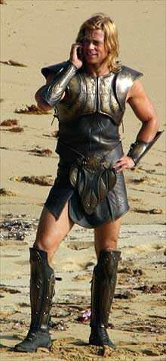
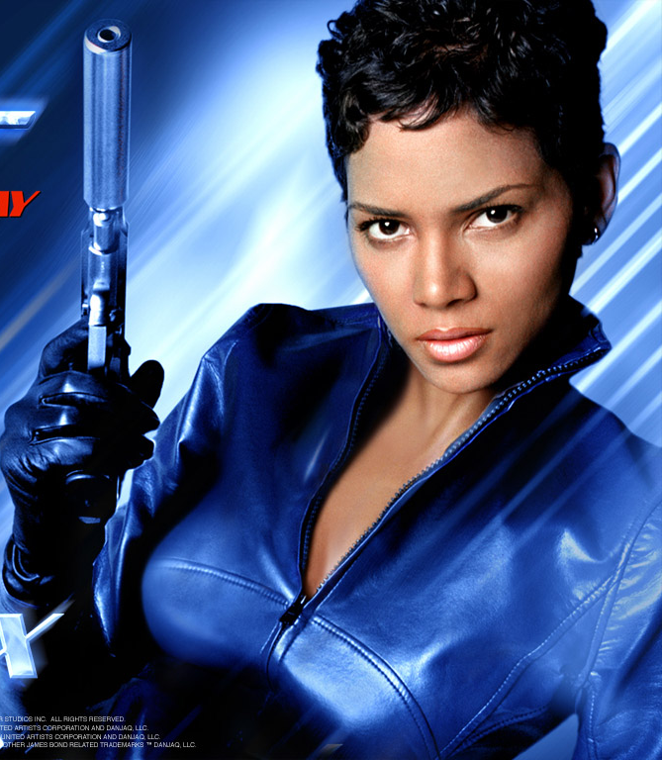
Who is the fairest of them all?

Slide 7
Fiction Versus Reality
Does true love (really) exist?

Slide 8
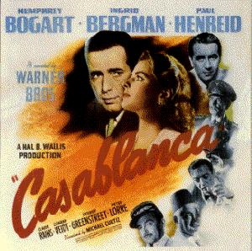

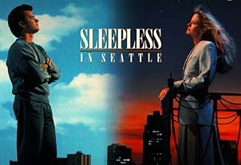

Slide 9
Fiction Versus Reality
Does true love (really) exist?
“Perfect love is rare indeed—for to be a lover will require that you continually have the subtlety of the very wise, the flexibility of the child, the sensitivity of the artist, the understanding of the philosopher, the acceptance of the saint, the tolerance of the scholar and the fortitude of the certain.”
Leo Buscaglia
Perfect love does not exist…
True love does exist…

Slide 10
Reframing Questions:
The Case of Relationships
Traditional psychology
  “Why do so many long-term relationships fail?”
Positive psychology
  “What makes some relationships thrive and grow stronger over time?”

Slide 11
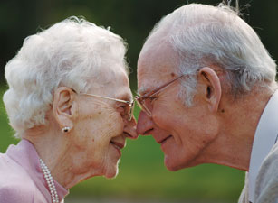
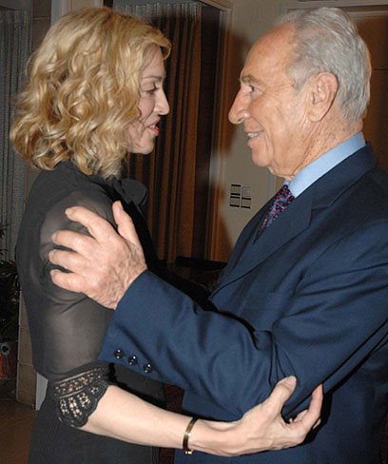
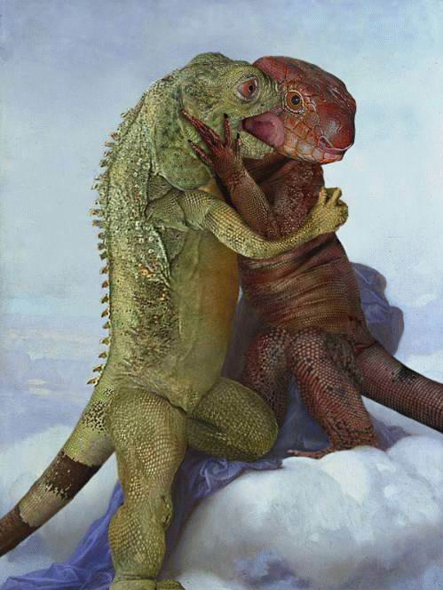
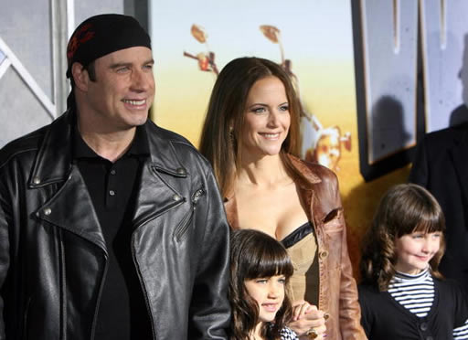

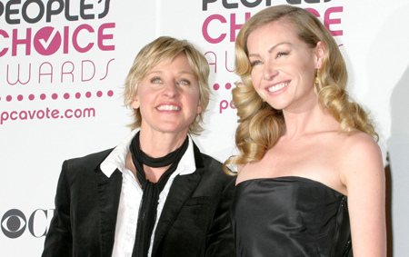
Learning from What Works

Slide 12
“At first, when I figured out how to predict divorce, I thought I had found the key to saving marriages... But like so many experts before me, I was wrong. I was not able to crack the code to saving marriages until I started to analyze what went right in happy marriages.”
John Gottman
“Cellulite and sexual potential are highly correlated.”
David Schnarch

Slide 13
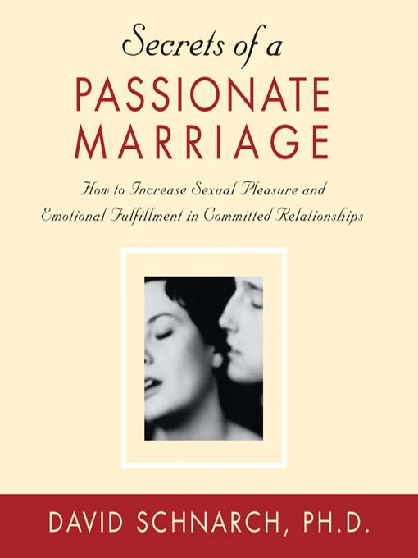
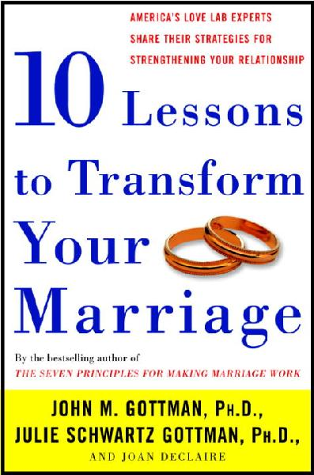
Growing Tip Statistics
Working hard
Striving to be known rather than validated
Allowing for conflict
Appreciating the positive

Slide 14
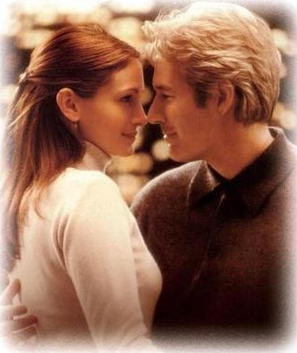
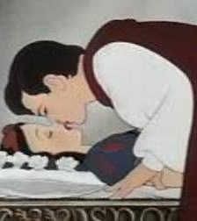
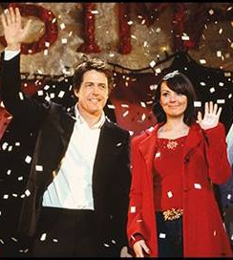
1. Working Hard
Cultivating versus Finding
Movies end where love begins
Living happily ever is the difficult part
The “one right person” theory
Cultivating the “one chosen” relationship

Slide 15
Being Together By Doing Together
Superordinate goal (Sherif, 1958)
Mutually meaningful goals
“In the strongest marriages, husband and wife share a deep sense of meaning. They don’t just ‘get along’—they also support each other’s hopes and aspirations and build a sense of purpose into their lives together.” John Gottman
Active love
Relationship rituals

Slide 16
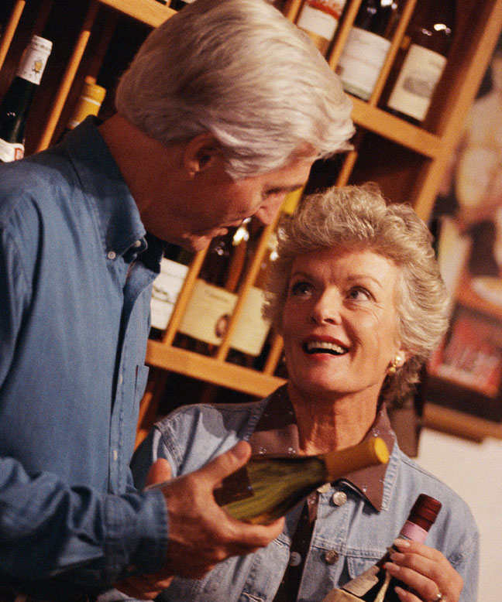
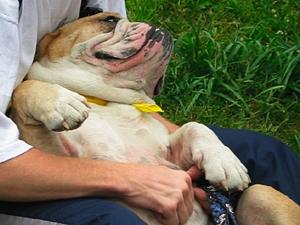
2. Being Known Rather than Validated
Intimacy as key to long-term passion
Open up, share, reveal
Express, not impress
Also get to know your partner (love maps)

Slide 17
Being Known Rather than Validated
“Intimacy is about letting yourself really be known, including parts that you or your partner don't like. But it's not just about letting "warts" be known. It often involves showing strengths you've been hiding, too. Most approaches focus on getting your partner's validation and acceptance when you disclose. But you can't count on this, and if you try, it inherently limits self-disclosure because you won't say things your partner won't validate. Resolving gridlock requires intimacy based on validating yourself.
Schnarch (1997)

Slide 18
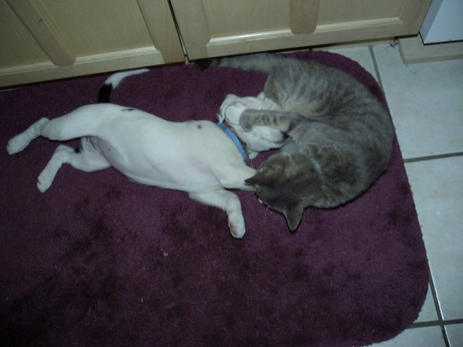
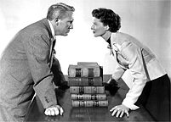
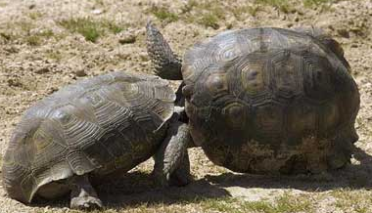
3. Allowing for Conflict
No one right relationship (Gottman, 2000)
5:1 positivity ratio
Conflict immunizes
Accentuate positive; don’t eliminate negative

Slide 19
Love Boosters
Love is in the details
Mini love boosters
  “60-second pleasure points” (Fraenkl, 2007)
Extraordinary by focusing on ordinary
Demonstrate interest
Show affection (touch, smile, flowers…)
Pay compliments
“I can live for two months on a good compliment.”
Mark Twain
Demonstrate empathy
Make love

Slide 20
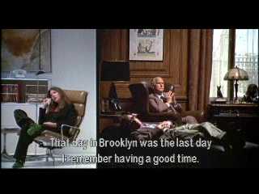

Slide 21
Positive Conflict
Affective rather than cognitive conflict
Challenging behavior, not person
  P: “You are so inconsiderate”
  B: “Do you mind putting down the toilet seat when you’re done?”
  P: “You are such a slob; you promised to throw away the garbage ; I can’t trust you.”
  B: “It upsets me to return to a dirty home, after we agreed that you would throw away the garbage.”

Slide 22
Positive Conflict
Affective rather than cognitive conflict
Challenging behavior, not person
Avoiding hostility, insults, contempt
Keeping disputes private
Conflict in gay couples (Gottman, 2001)
  More positive, using humor and affection
  Not taking negativity personally
  Calm down and soothe one another

Slide 23
The Titanium Rule
“Do not do unto those close to you what you would not have done unto others (who’re not so close to you).”

Slide 24
Deep Friendship
“At the heart of my program is the simple truth that happy marriages are based on a deep friendship. By this I mean a mutual respect for and enjoyment of each other’s company. These couples tend to know each other intimately—they are well versed in each other’s likes, dislikes, personality quirks, hopes, and dreams. They have an abiding regard for each other and express this fondness not just in the big ways, but in little ways day in and day out.”
John Gottman

Slide 25

4. Positive Perception
Benefit finding (appreciating)
Positive illusions (Murray, 1997)
A self-fulfilling prophecy (benefit creating)
“Not only does love perceive potentialities but it also actualizes them.”
Abraham Maslow

Slide 26
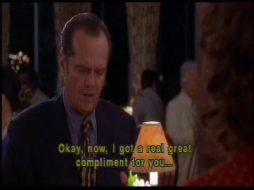

Slide 27
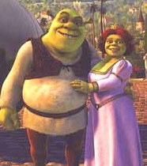
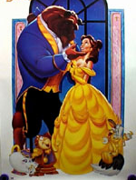
Refocusing on the Positive
What am I grateful for in my partner?
What is wonderful about our relationship?

Slide 28
Communicating about Positive Events
(Gable et al., 2006)
Responding to positive-event-disclosures
Active constructive responding

Slide 29
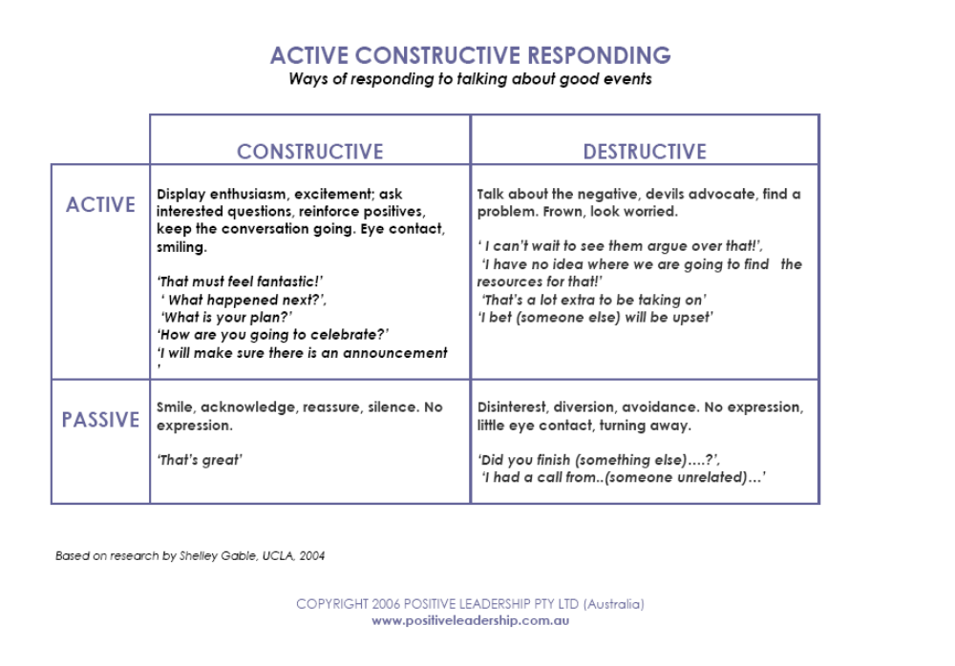

Slide 30
Communicating about Positive Events
(Gable et al., 2006)
Responding to positive-event-disclosures
Active constructive responding
  Win-win events
  Genuine responding
  Generating upward spirals (promoting positive)
  Building positive capacity (dealing with negative)

Slide 31
Bibliography and Recommendations
Bem, D. J. (1996). Exotic Becomes Erotic: A Developmental Theory of Sexual Orientation. Psychological Review, 103 (2), 320-335)
Branden, N. (1985). The Psychology of Romantic Love. Bantam
Fraley, R. C. & Shaver, P. R. (2000). Adult Romantic Attachment: Theoretical Developments, Emerging Controversies, and Unanswered Questions. Review of General Psychology, 4 (2), 132-154.
Gottman, J. M. (2000). The Seven Principles for Making Marriage Work: A Practical Guide from the Country’s Foremost Relationship Expert. Three Rivers Press.
Murray, S. L., & Holmes, J. G. (1997). A leap of faith? Positive illusions in romantic relationships. Personality and Social Psychology Bulletin, 23, 586-604.
Schnarch, D. (1998). Passionate Marriage: Keeping Love and Intimacy Alive in Committed Relationships. Owl Books.
Sternberg, R. J. & Barnes, M. L. (1989). The Psychology of Love. Yale University Press.

